Slide 1
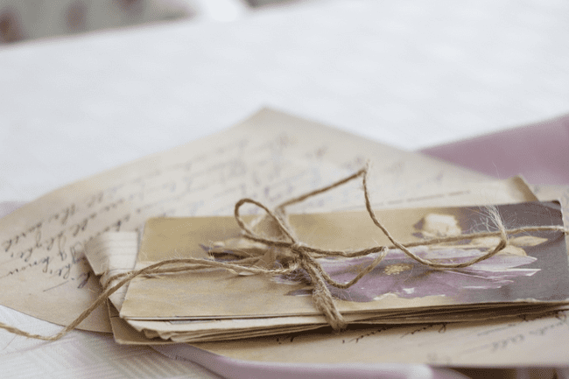
A Time for Letters
Notes:
Image of letters, free for use under the Pixabay Content License

Slide 2

Aims:
To read and analyse letters written in the 18th century
To write our own letter in a similar style
To compare communication in the past and present
Notes:
Portrait of a boy, British eighteenth century; https://www.mutualart.com/Artwork/Portrait-of-a-boy--half-length--in-a-whi/52FF99DC71A7C835
Young Woman Writing a Letter, Pietro Antonio Rotari (Italian, 1707-1762), c. 1755-60

Slide 3
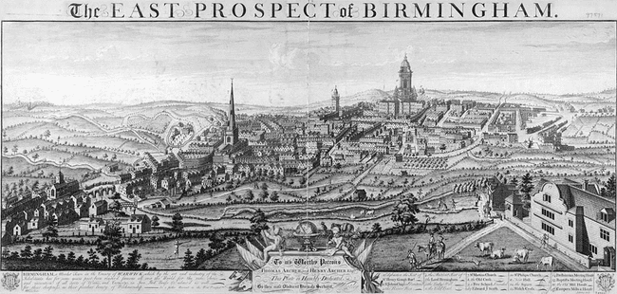
Notes:
The East Prospect of Birmingham (1732), engraving by William Westley (Wikimedia Commons, public domain) https://commons.wikimedia.org/wiki/File:Westley---East-Prospect-of-Birmingham-1732.jpg

Slide 4
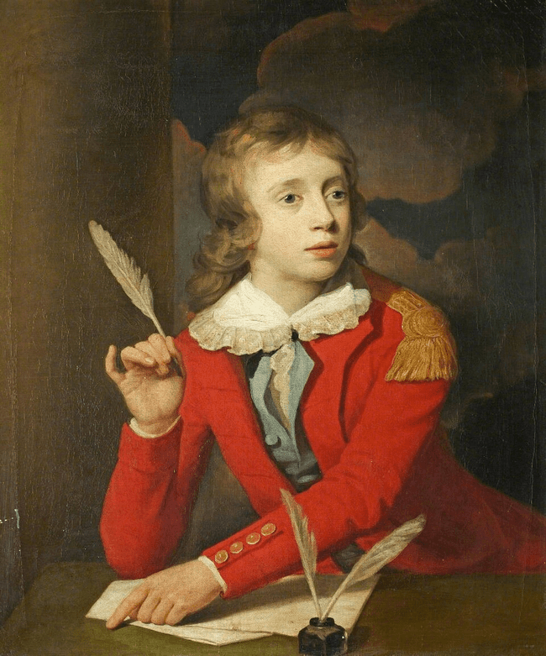
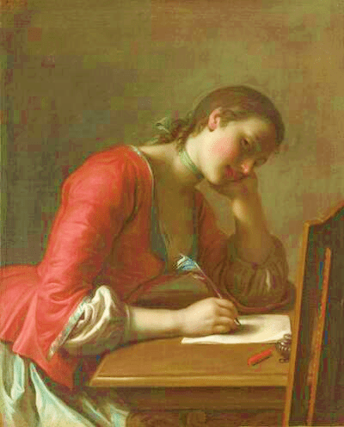
Notes:
‘Henry Hoare (1784–1836), Son of Sir Richard Colt Hoare, as a Boy, Writing a Letter’, by Samuel Woodforde, 732202 - National Trust (Wikimedia Commons, public domain) https://commons.wikimedia.org/wiki/File:Samuel_Woodforde_(1763-1817)_-_Henry_Hoare_(1784%E2%80%931836),_Son_of_Sir_Richard_Colt_Hoare,_as_a_Boy,_Writing_a_Letter_-_732202_-_National_Trust.jpg
'Young Girl Writing a Love Letter' by Pietro Antonio Rotari, Norton Simon Museum (Wikimedia Commons, public domain) https://commons.wikimedia.org/wiki/File:%27Young_Girl_Writing_a_Love_Letter%27_by_Pietro_Antonio_Rotari,_Norton_Simon_Museum.JPG

Slide 5
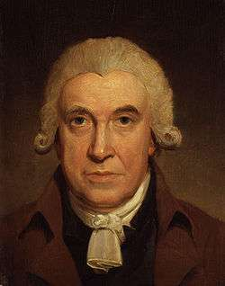
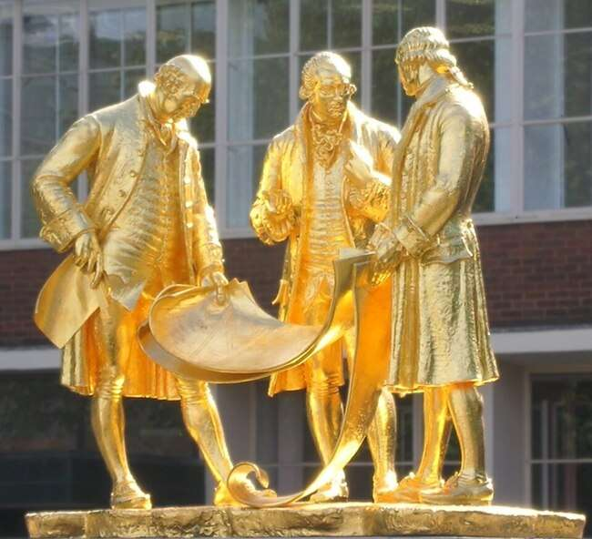
James Watt:
engineer and scientist
Notes:
Image of statue of Boulton, Watt and Murdoch, Oosoom at English Wikipedia (Wikimedia Commons, licensed under the Creative Commons Attribution-Share Alike 3.0 Unported license) https://commons.wikimedia.org/wiki/File:Boulton,_Watt_and_Murdoch.jpg
Portrait of James Watt by Henry Howard, National Portrait Gallery, London (Wikimedia Commons, public domain) https://commons.wikimedia.org/wiki/File:James_Watt_by_Henry_Howard.jpg

Slide 6
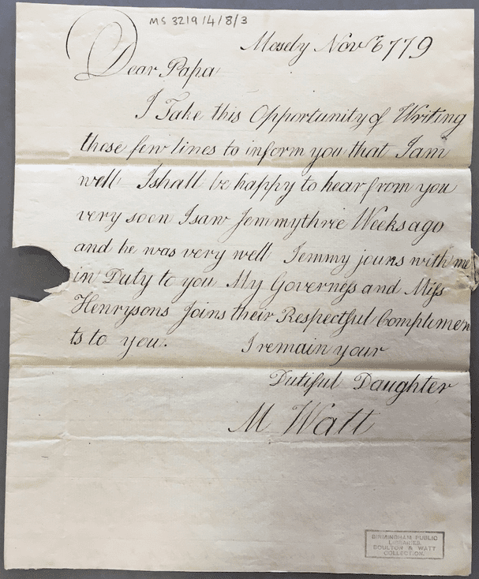
Letter 1: Margaret Watt to her father James Watt, 6 November 1779

Slide 7
Mosely Nov^{r} 6 779
Dear Papa,
I Take this Opportunity of Writing
these few lines to inform you that I am
well I shall be happy to hear from you
very soon I saw Jemmy three Weeks ago
and he was very well. Jemmy jouns with me
in Duty to you. My Governess and Miss
Henrysons Joins their Respectful Complimen
ts to you.
I remain your
Dutiful Daughter
M Watt

Slide 8

Discussion questions:
What is Margaret’s purpose here?
How would you describe her relationship with her father?
How would you describe the handwriting?

Slide 9
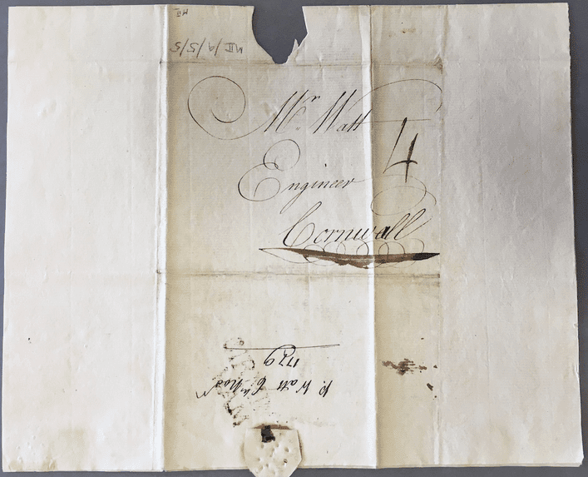

Slide 10
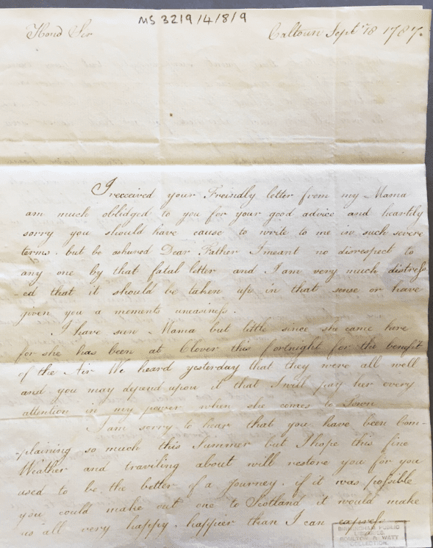
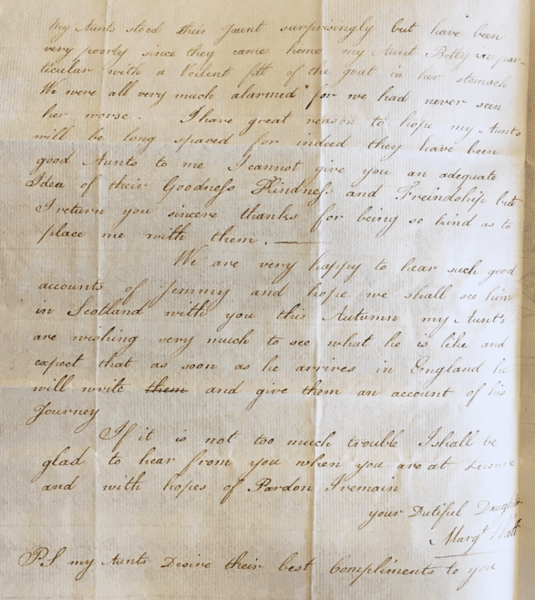
Letter 2: Margaret Watt to her father James Watt, 18 September 1787

Slide 11
Caltoun Septr 18 1787
Hond Sir
I received your Freindly letter from my Mama
am much oblidged to you for your good advice and heartily
sorry you should have cause to write to me in such severe
terms but be ashured Dear Father I meant no disrespect to
any one by that fatal letter and I am very much distress-
-ed that it should be taken up in that sense or have
given you a moments uneasiness.
I have seen Mama but little since she came here
for she has been at Clover this fortnight for the benefit
of the Air. We heard yesterday that they were all well
and you may depend upon it that I will pay her every
attention in my power when she comes to Town -
I am sorry to hear that you have been Com-
-plaining so much this Summer but I hope this fine
Weather and traviling about will restore you, if it was possible
you could make a out one to Scotland it would make
us all very happy, happier than I can express.
My Aunts have been
good Aunts to me I cannot give you an adequate
Idea of their Goodness Kindness and Friendship but
I return you sincere thanks for being so kind as to
place me with them
[…]
If it is not too much trouble I shall be
glad to hear from you when you are at Leisure
and with hopes of Pardon I remain
your Dutiful Daughter
Margt Watt
PS my Aunts Desire their best Compliments to you

Slide 12
Discussion questions:
What is Margaret’s purpose here? What techniques/language does she use to achieve it?
How has her relationship with her father changed since Letter 1?
What do you think happened before this letter?
Any interesting spellings/uses of grammar?

Slide 13

Continue the conversation…
Write a reply to Margaret’s letter (Letter 2) as if you were James.
Think about…
Form (date, address, sign-off)
Structure (how will you open?)
Content (what do you need/want to say? Any questions to ask?)
Tone (how will you be feeling?)
Language (if you can, try to write in the same style and using similar vocabulary to letters we have read today)

Slide 14
Discussion question:
What are the advantages and disadvantages of letter writing compared with modern forms of communication?
Notes:
‘Henry Hoare (1784–1836), Son of Sir Richard Colt Hoare, as a Boy, Writing a Letter’, by Samuel Woodforde, 732202 - National Trust (Wikimedia Commons, public domain) https://commons.wikimedia.org/wiki/File:Samuel_Woodforde_(1763-1817)_-_Henry_Hoare_(1784%E2%80%931836),_Son_of_Sir_Richard_Colt_Hoare,_as_a_Boy,_Writing_a_Letter_-_732202_-_National_Trust.jpg

